Slide 1


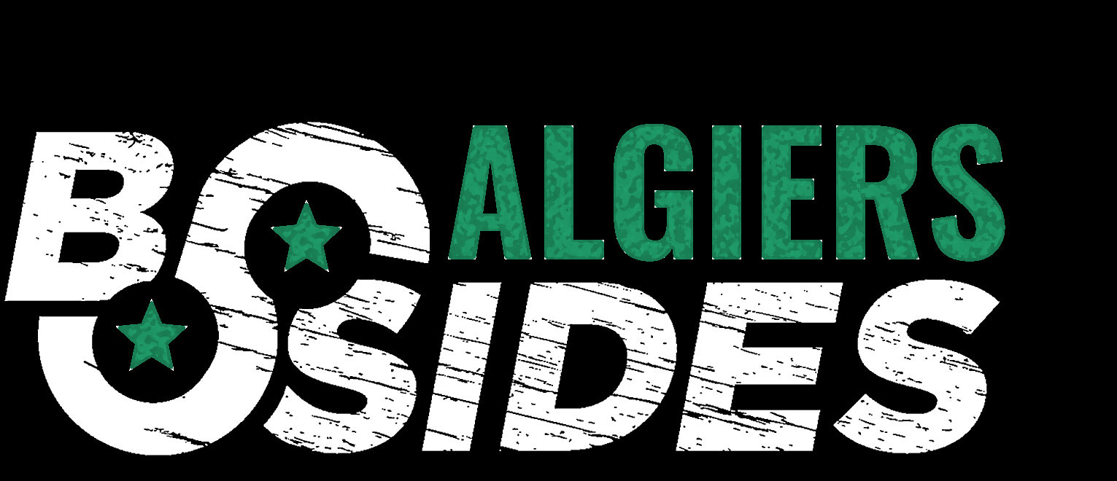
Client-side Security
Client-side web exploitation : attacks and mitigation

Slide 2


Mokrane Abdelmalek
Oussama Merouan
3rd year CS student at ESI, Dev co-manager at GDG Algiers.
Third year student at ESI, Technical department manager at Shellmates.
Cyber security enthusiasts and CTF players at @ShellSec and @CyberErudites

Slide 3
TABLE OF CONTENTS
01
02
Cross Site Scripting
Cross Site Request Forgery
Client-side vs. Server-side
03
04
Clickjacking
05
SOP / CORS
06
Mitigations

Slide 4

Client-side Vs.
Server-side

Slide 5
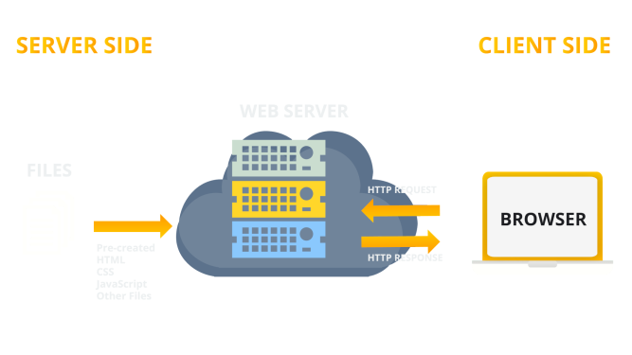
Client-side Vs. Server-side
Notes:
Frontend vs Backend
CSR vs SSR
Form validation
Server side is more secure than client side

Slide 6

Client-side vulnerabilities
Security incidents and breaches
Notes:
Attacks that occur on the user side and the browser, also between the server and the client.
The rise of online services and web experiences
User input and interaction

Slide 7

Client-side vulnerabilities

Slide 8

Cross Site
Scripting

Slide 9
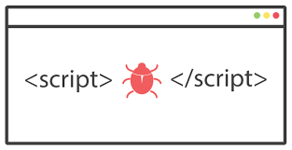
Cross Site Scripting (XSS)
A type of client side code injection attack. The attacker intends to run harmful scripts in the victim's web browser by embedding malicious code in a web page.

Slide 10
What you can do with XSS
01
02
03
04
Hijack a user’s session
Perform unauthorized activities
Perform phishing attacks
Steal sensitive information

Slide 11
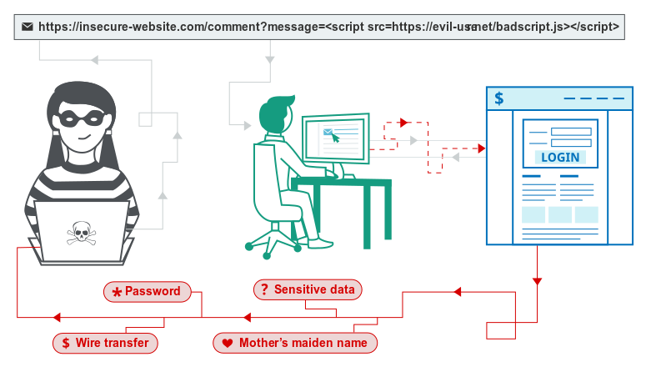
Cross Site Scripting - Reflected

Slide 12
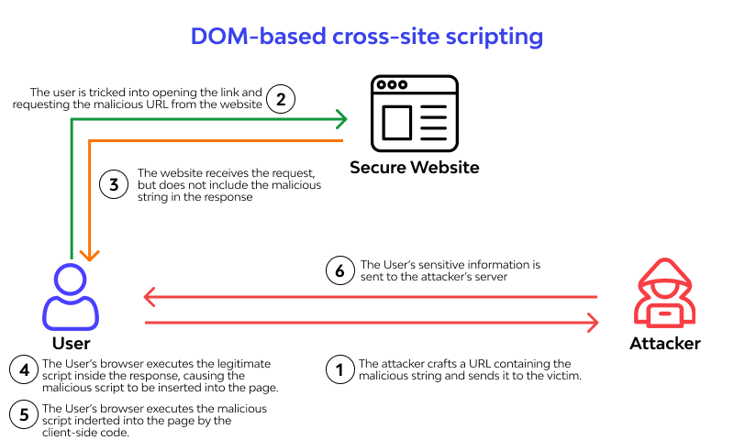
Cross Site Scripting - DOM

Slide 13
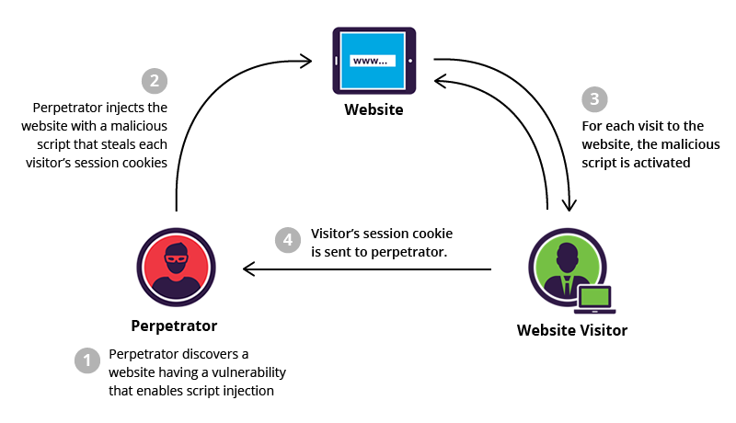
Cross Site Scripting - Stored

Slide 14

Cross Site
Request
Forgery

Slide 15
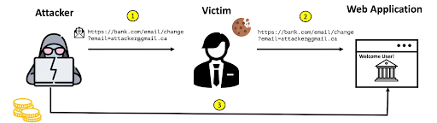
II. Cross Site Request Forgery
CSRF is an attack where the attacker causes the victim user to carry out an action unintentionally while that user is authenticated .

Slide 16
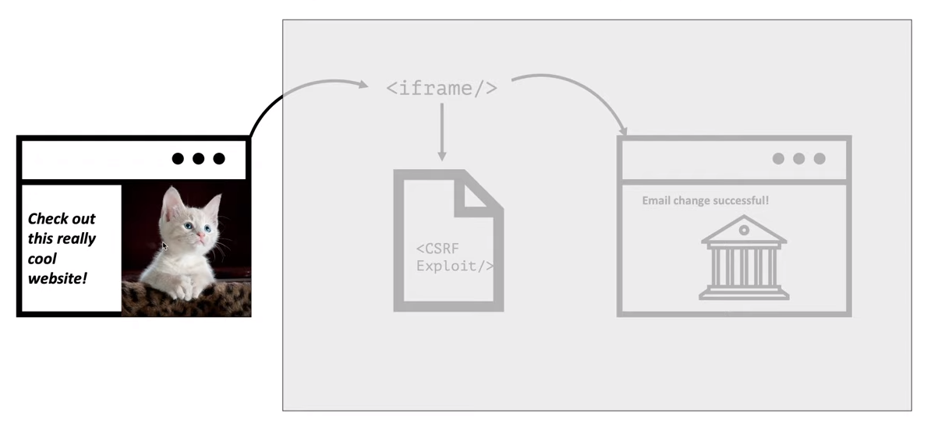
II. Cross Site Request Forgery

Slide 17
What you can do with CSRF
01
02
03
04
Change email
Transfer amount
Delete records (emails, blogs, etc)
Perform high
privilege actions

Slide 18
II. Cross Site Request Forgery
CSRF conditions:
A relevant action.
Cookie-based session handling.
No unpredictable request parameters.

Slide 19
Clickjacking

Slide 20
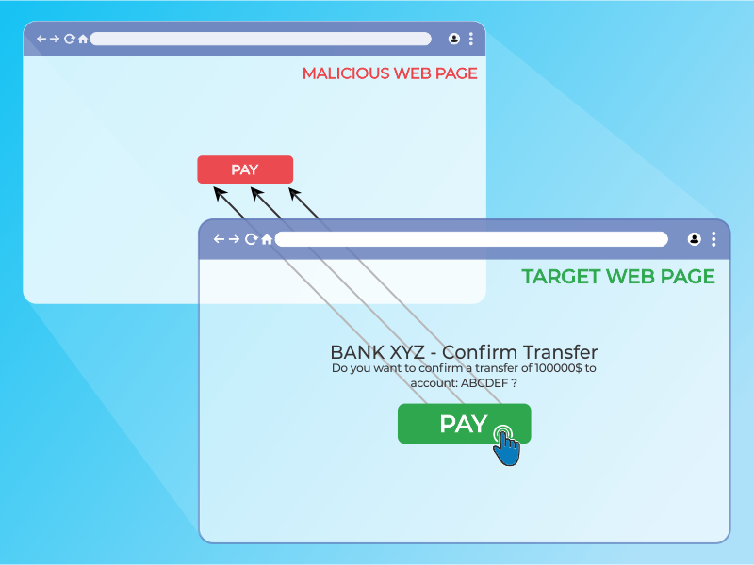
III. Clickjacking
Clickjacking is a type of attack in which a user is tricked into clicking on a webpage element that is either invisible or disguised as another element.

Slide 21
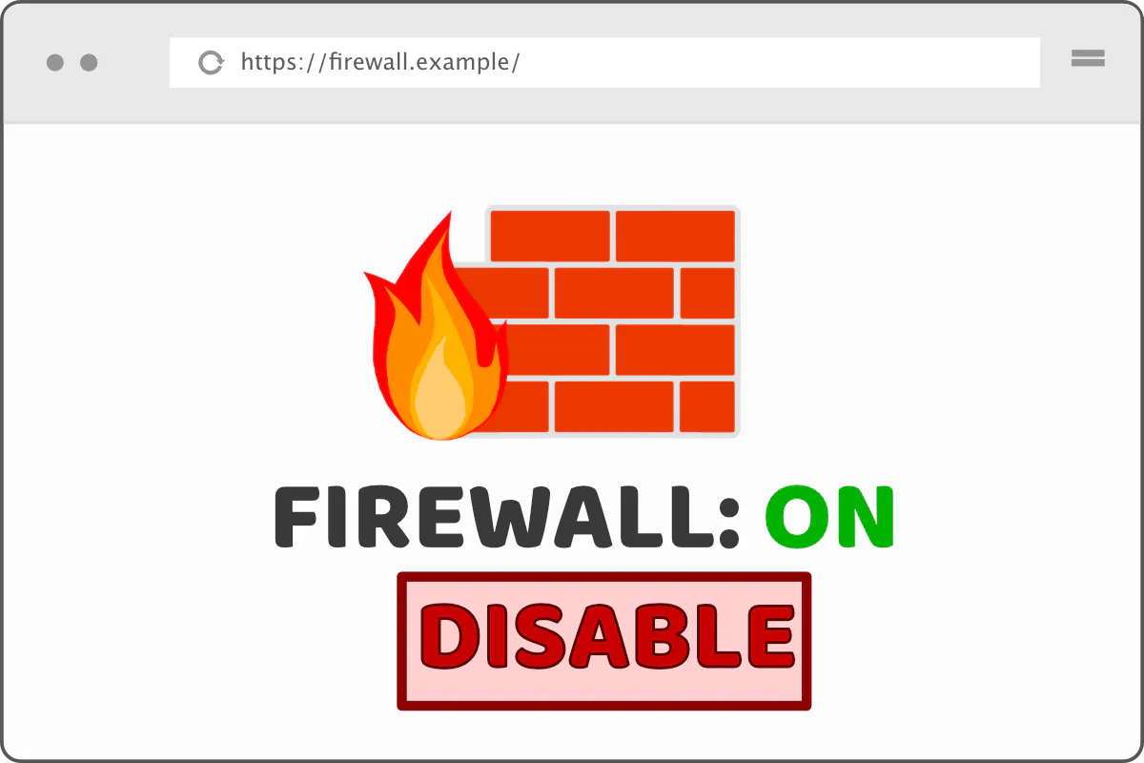
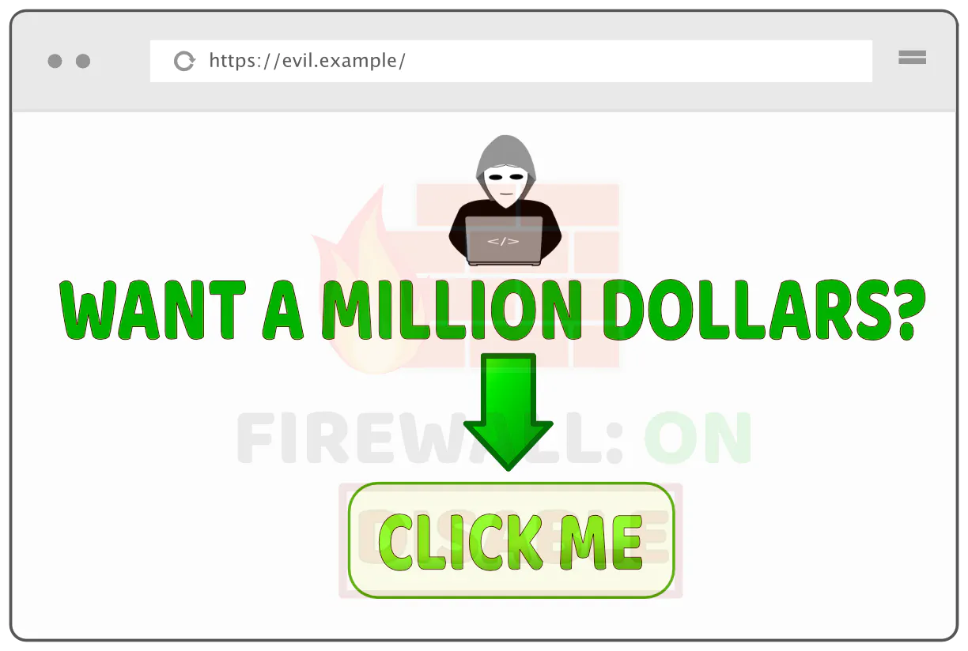
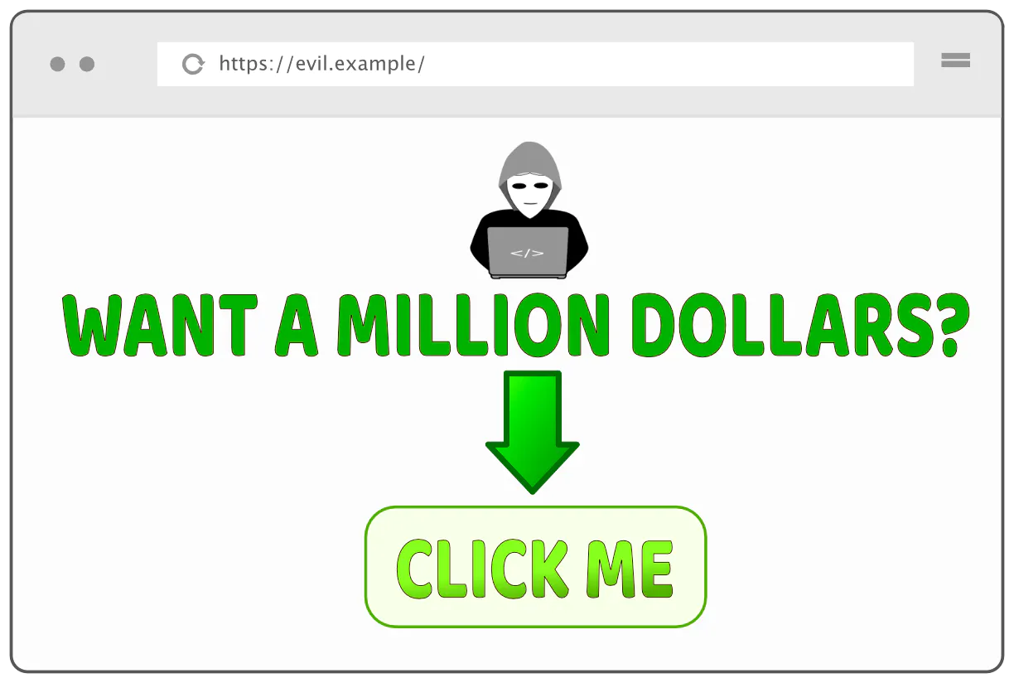
III. Clickjacking
01
02
03

Slide 22
III. Clickjacking - Types
Likejacking
Cookiejacking
Filejacking
Cursorjacking
Password manager attacks

Slide 23
SOP / CORS

Slide 24
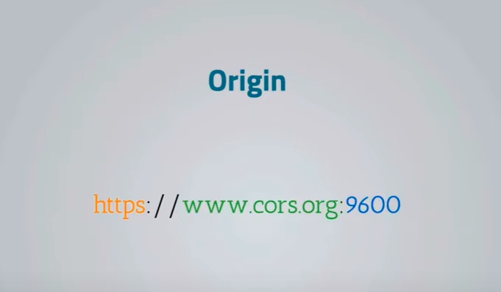
Same Origin Policy
Same Origin Policy is a security mechanism that limits how a document or script loaded from one origin interacts with a resource from another.

Slide 25
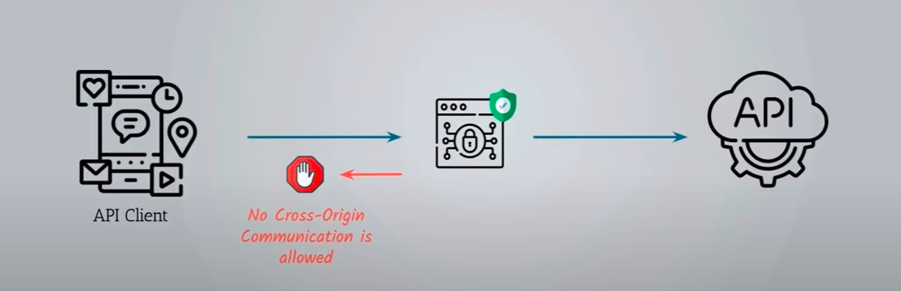
II. Cross-Origin Resource Sharing (CORS)
Cross Origin Resource sharing is another browser mechanism which enables controlled access to resources located outside of a given domain.

Slide 26
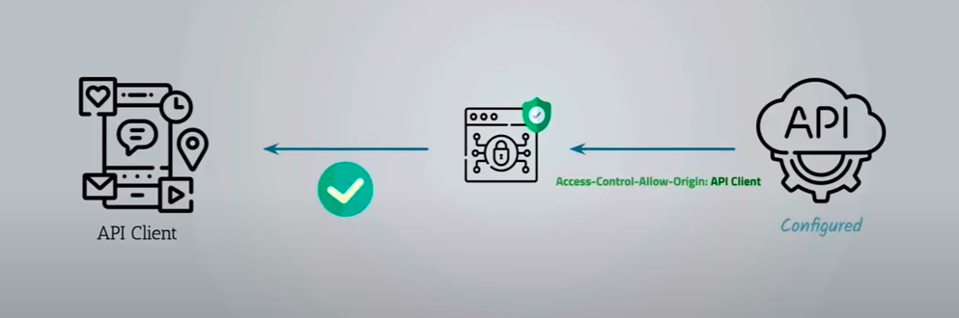
II. Cross-Origin Resource Sharing (CORS)
Access-Control-Allow-Origin header permits us to specify the origins that can fetch our API.

Slide 27

Mitigations
How to protect?

Slide 28
Mitigations

Slide 29
XSS
User Input Sanitization
Use DOMPurify
HttpOnly cookies
resp.set_cookie("name", value = "value", httponly = True)
Using CSP
Content-Security-Policy: script-src 'self'
userInput.replace(/</g, "&lt;").replace(/>/g, "&gt;")
.replace(/’/g, "2#39;").replace(/"/g, "&quot;")
.replace(/&/g, "&amp;");

Slide 30
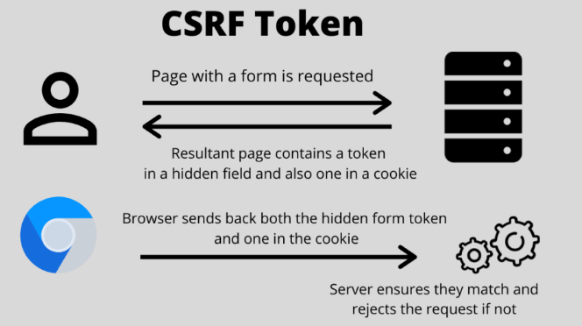
II. CSRF
CSRF-TOKEN
Unpredictable with high entropy, as for session tokens in general.
Tied to the user's session.
Strictly validated in every case before the relevant action is executed.

Slide 31
III. Clickjacking
X-Frame-Options
X-Frame-Options: DENY
X-Frame-Options: SAMEORIGIN
Using cookie's sameSite origin
resp.set_cookie("name", value = "value", samesite="Strict")
Using CSP
Content-Security-Policy: script-src-elem <source>

Slide 32
Conclusion
If you find a vulnerability, you go ahead and fix it. You don't base your security on:
Luck
Difficulty of exploitation
Requiring intimate knowledge of your code which you assume no one has.

Slide 33
Any questions?
jm_abdelmalek@esi.dz
jo_merouan@esi.dz
Thank you for your attention
/m0kr4n3/
/ouxs11/
/m0kr4n3
/ouxs11

